Slide 1
Text Classification Model for Subreddit
Leveraging NLP for Binary Text Classification
By: Damar Shipp
Contact: LinkedIn

Slide 2
TABLE OF CONTENTS
03
04
DATA OVERVIEW
METHODOLOGY
02
01
PROBLEM & SOLUTION
TARGET
Next Steps
05
Conclusion
06
EDA
MODEL PERFORMANCE
08
07
⌖
Objective: Show the data we used to create the model.
Objective: Show what features were used to create the model.
⏭
Objective: Classify
Subreddit post based on their given text by a classification model.
⏛
Objective: Identify target audience
⍬
⏱
Objective: Show
possible
improvements
for the model
Objective: Show
Findings and
recommendations.
Objective: Steps taken to ensure the model works properly.
Objective: Show how the model performed.

Slide 3
Target Audience
Target:
Platform moderators and data analyst/ researchers

Slide 4
PROBLEM STATEMENT
Problem
Solution
- Reddit is comprised of numerous communities known as subreddits, where each subreddit is tailored to a specific interest, and misclassified posts can disrupt community discussions and reduce user engagement. To address this; I have tailored this project to develop and evaluate two supervised learning models that will determine which subreddit the post belongs to.
Develop and evaluate two supervised learning models that will determine which subreddit the post belongs to.

Slide 5
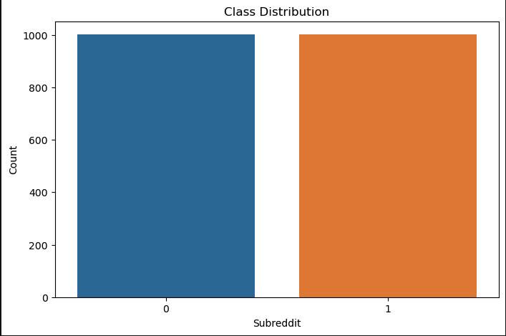
DATA OVERVIEW
SOURCE
Challenge
SIZE OF DATA
COLLECTED posts from two subreddits using PRAW
Extra text
Dataset size: 2004
New Data Size: 1880

Slide 6
METHODOLOGY
Pipeline Overview:
Data preprocessing (stop words removal, lemmatization).
Feature extraction (vectorization).
Model selection: Logistic Regression and Random Forest.
Evaluation using accuracy and classification report
• Justification: Models chosen for interpretability and performance

Slide 7
Exploratory Data Analysis (EDA)
Visualizations:
Term frequency distribution plots.
Insights: Key words and patterns indicate distinct subreddit behaviors.

Slide 8
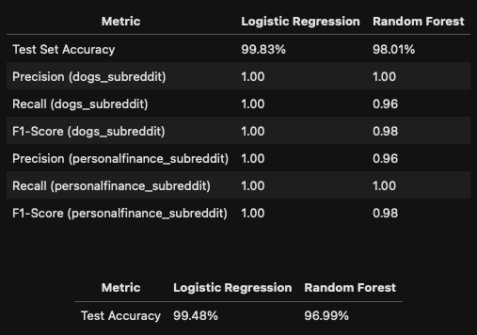
MODEL PERFORMANCE
METRICS:
ACCURACY, PRECISION, RECALL, F1-SCORE.
CONFUSION MATRICES FOR BOTH MODELS
HOW THE MODEL PERFORMED ON A NEW DATA.
BEST MODEL: LOGISTIC REGRESSION ACHIEVED THE HIGHEST SCORE ON ALL CATEGORIES. 1.00 = 100%

Slide 9
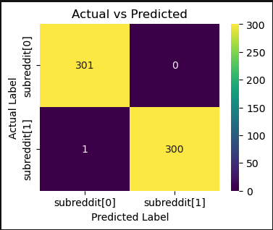
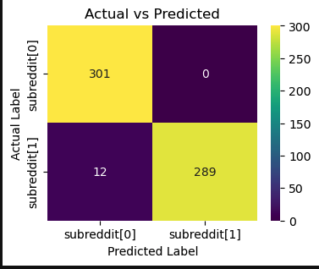
CONCLUSION & KEY FINDINGS
Key Findings:
• - Text classification is effective with proper preprocessing.
• Model Recommendation:
• - Logistic Regression model due to its high accuracy.
Impact: Enhances subreddit content analysis for targeted actions.
Left side:
Logistics Regression Model
Right side:
Random Forest Model

Slide 10
Next Steps
Improvements:
Incorporate more data.
Extend the model to classify posts across more subreddits for testing.
Experiment with other models and maybe more hyperparameters.
Applications:
I would feel 100% positive using my model in live action as the accuracy is high enough to not make a drastic negative effect.

Slide 11
Questions
⁇

